Slide 1
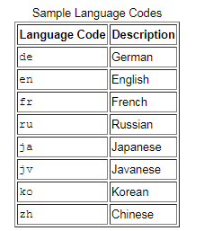
Codes in Locale
Codes
Language code
The optional script
Region
Variant codes
Language Code
The language code is either two or three lowercase letters that conform to the ISO 639 standard.

Slide 2
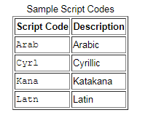
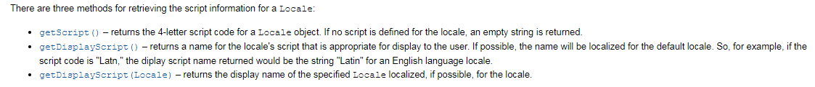
Codes in Locale
Script Code
The script code begins with an uppercase letter followed by three lowercase letters and conforms to the ISO 15924 standard.

Slide 3
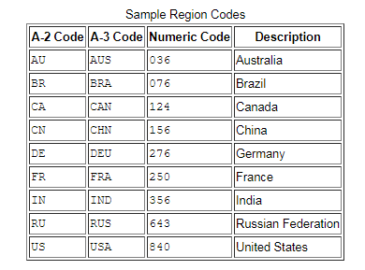
Codes in Locale
Region Code
The region (country) code consists of either two or three uppercase letters that conform to the ISO 3166 standard, or three numbers that conform to the UN M.49 standard.

Slide 4
Codes in Locale
Variant Code
The optional variant code can be used to further distinguish your Locale. For example, the variant code can be used to indicate dialectical differences that are not covered by the region code.

Slide 5
TimerTask
http://www.loc.gov/standards/iso639-2/php/code_list.php
http://unicode.org/iso15924/iso15924-codes.html
http://www.chemie.fu-berlin.de/diverse/doc/ISO_3166.html

